Slide 1
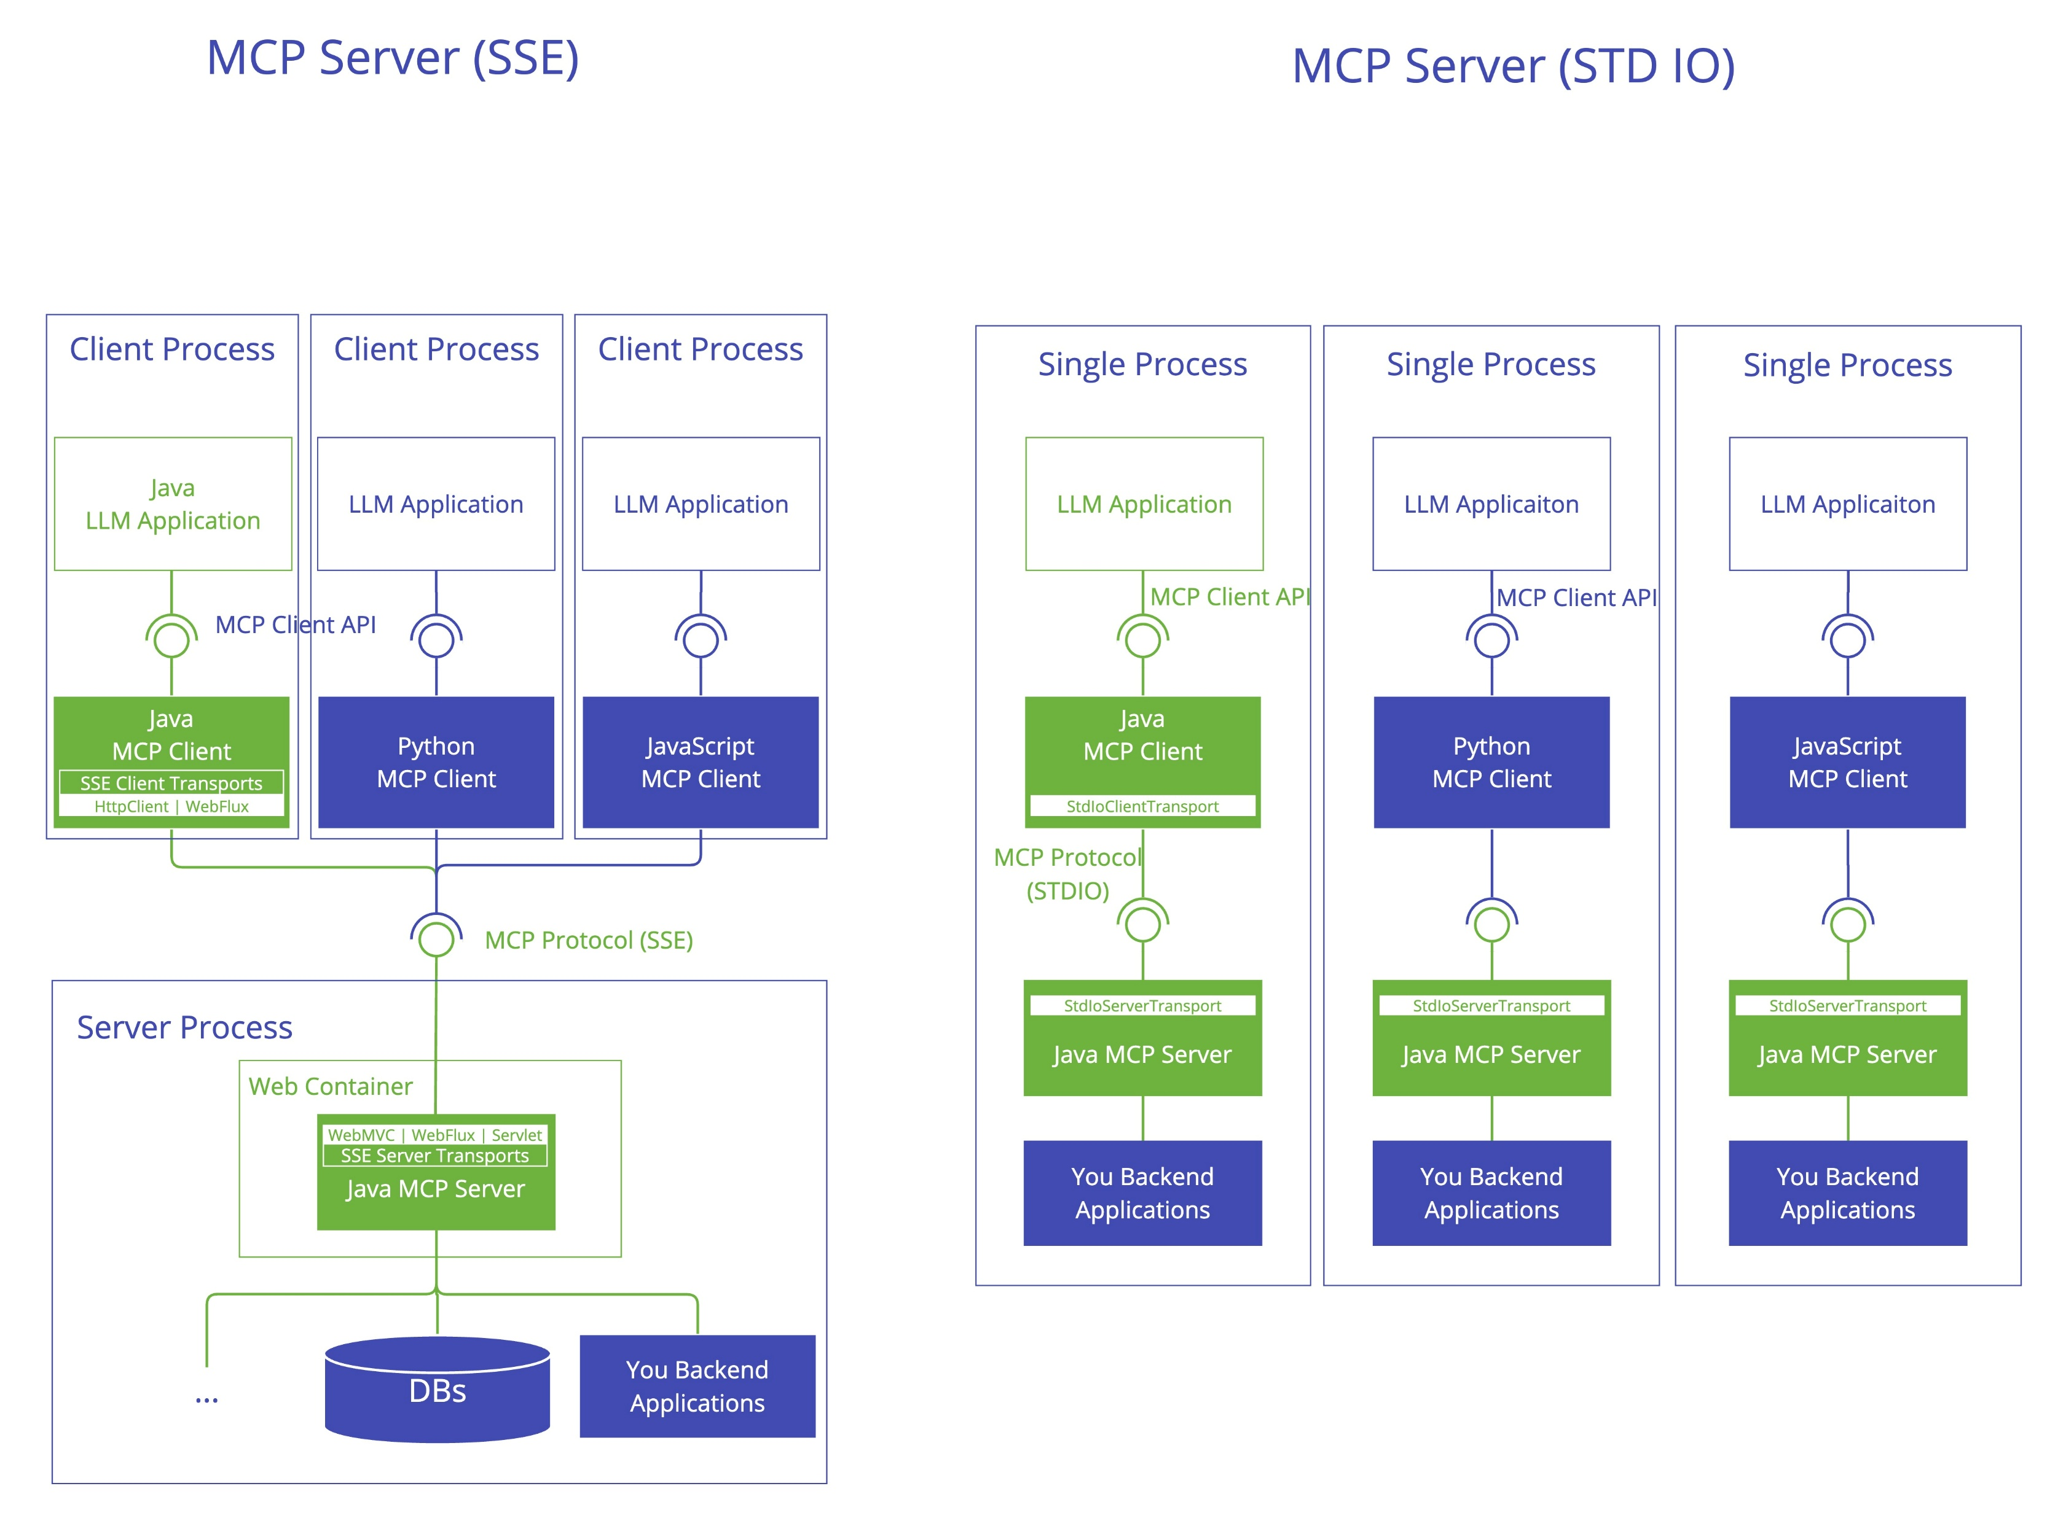
Model Context Protocols (MCP server)

